Slide 1
College
Majors and Minors
College Prep
Mr. Gordon
jgordon@bisdtx.org

Slide 2
Upcoming Events
8/27 First Day of ACC
StuCo Applications to be an Officer Due 8/30
hi

Slide 3
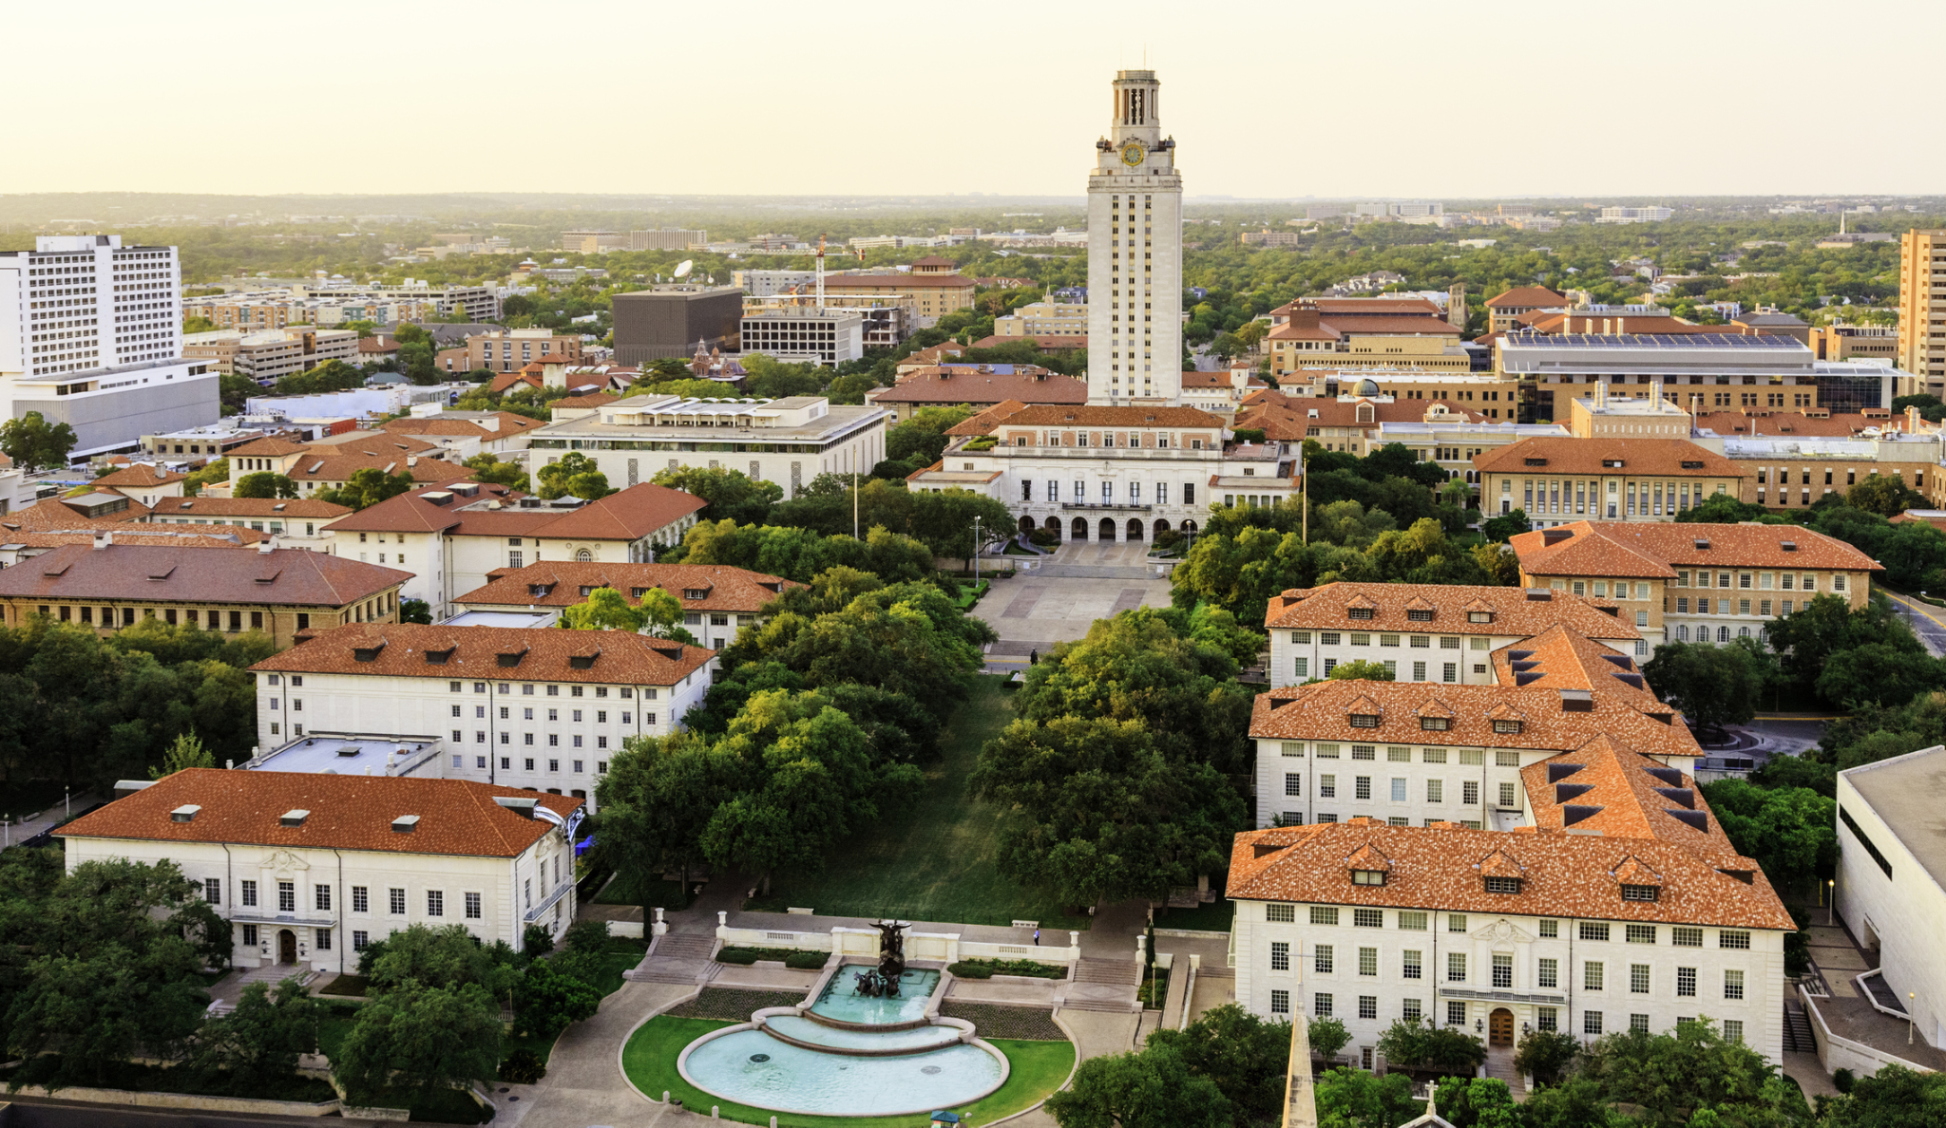
What are Majors and Minors?
Understanding what a college major and minor is, and the difference between the two is important as you begin your college career.
The University of Texas at Austin
hi

Slide 4
Majors and Minors
Major: the primary area of interest that you plan on getting a career in, required to graduate from college. The majority of your college classes will be in this concentration. Examples include nursing, engineering, education, and business.
hi

Slide 5
Majors and Minors
Your major will usually fall into
two categories:
Bachelor of the Arts (B.A.)
or Bachelor of Science (B.S.)
To fulfill your major, you will need to complete a list of required courses.
hi

Slide 6
Majors and Minors
Minor: the secondary area of interest that usually complements the major, but does not have to.
For example, if I wanted to be a Spanish teacher, I may major in education and minor in Spanish
or if I wanted to design video games, I may major in computer science and minor in art.
Minors can help you narrow down what you want to do as a career.
hi

Slide 7
Majors and Minors
Go to
https://www.ttu.edu/majors-and-colleges/undergraduate-majors/
for a list of all majors that Texas Tech University in Lubbock offers.
And here is the list of majors for Texas State University in San Marcos.
Pick 1 university and scroll through their majors.
Pick 3 majors that interest you.
hi

Slide 8
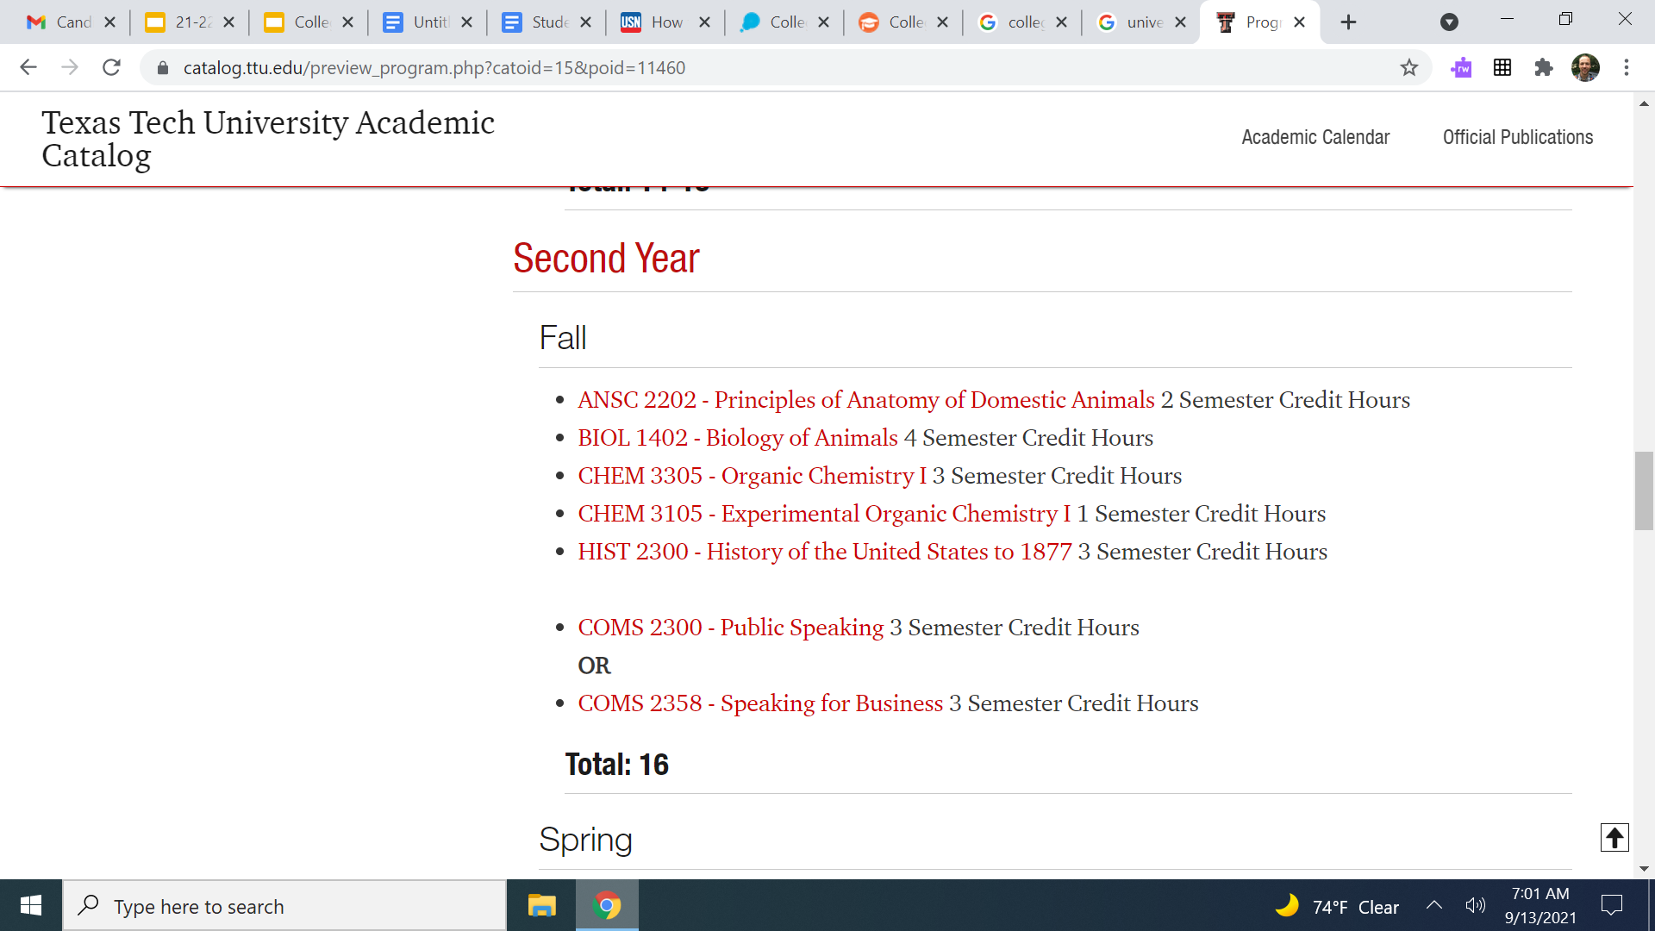
Majors and Minors
If you click on the major it will take you to the degree plan (required classes) for that major. Below is a screenshot of the Fall Semester of Sophomore year for Animal Science- Pre-Veterinary.
*Some of Texas State’s will not have the degree plan listed.
hi

Slide 9
Today’s College Prep Assignment
In the comments section of today’s College Prep,
list the three majors you are interested in and one class that is required for that major.
hi

